Slide 1
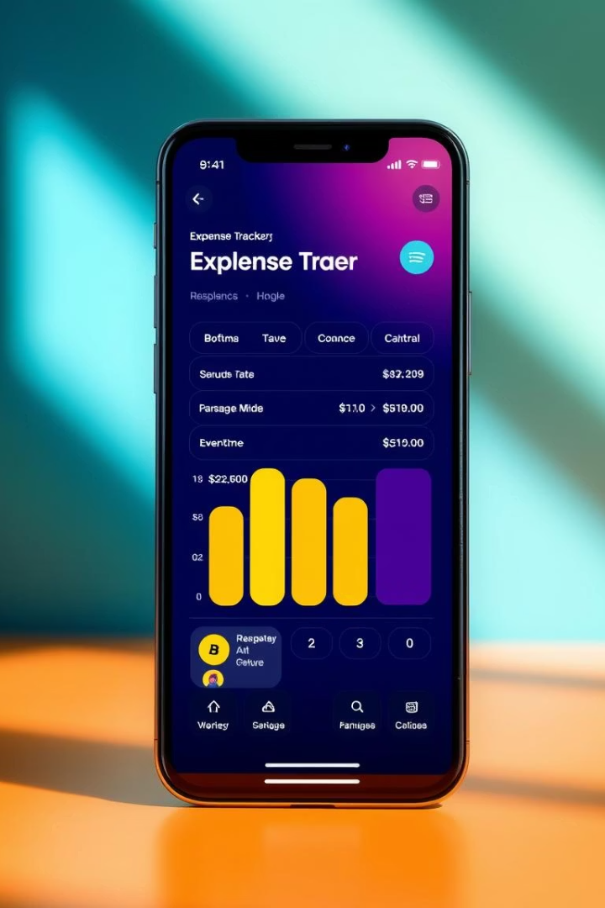
Smart Budgeting for Students & Savers: Expense Tracker App
Presented by Arya Manoj Madhavi
Class D15B, Roll No: 29, MAD Mobile App Development

Slide 2
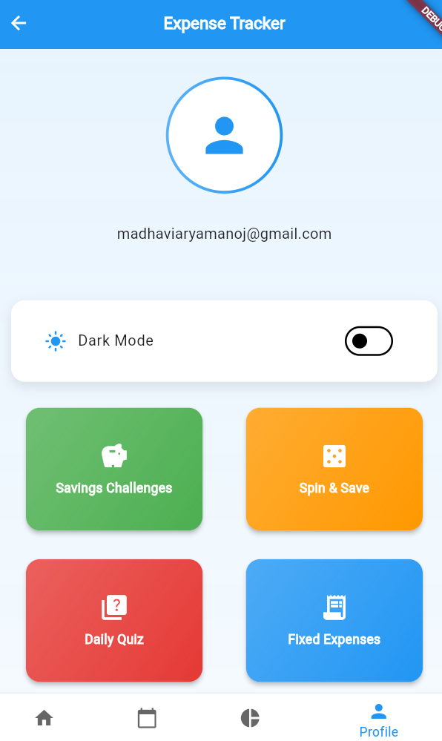
App Overview: Next-Gen
Personal Finance
Designed for students and daily budget-conscious users.
Focuses on usability, insights, and engagement.
Simplifies financial management for everyday use.
Built with Flutter and Firebase tech stack.

Slide 3

User Authentication: Secure & Streamlined
User Registration
Email Verification
Name, Email, and Password input stored as 'unverified'.
Secure token link sent via email for account activation.
Example Link
yourdomain.com/verify?token=uniqueToken

Slide 4
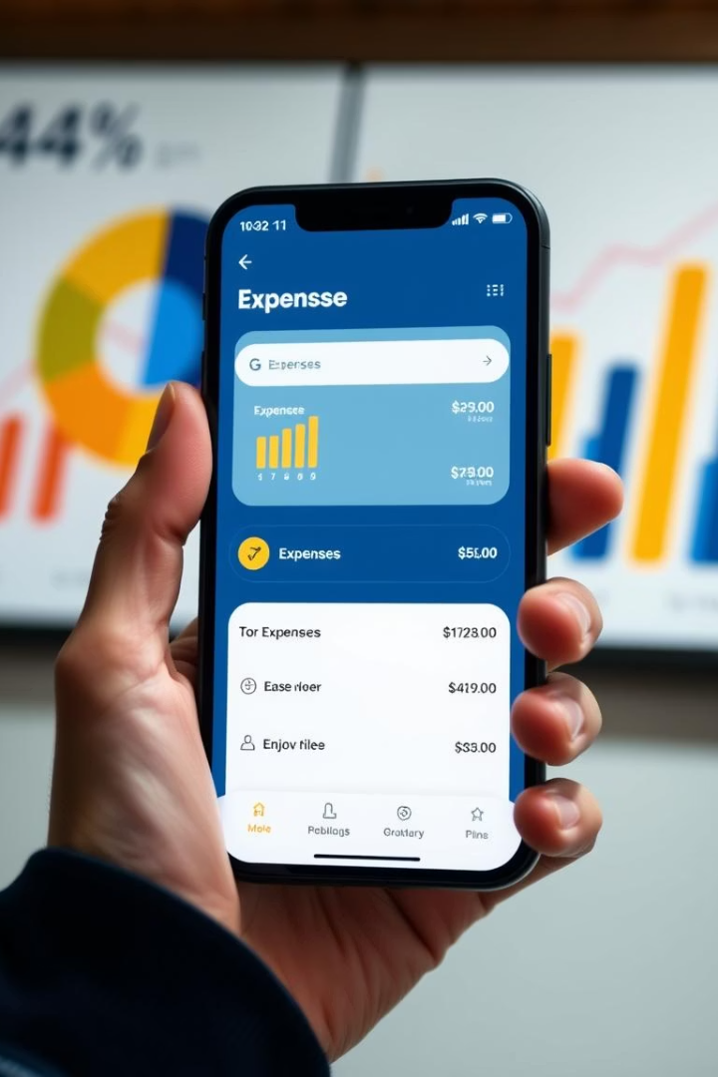
Core Features: Expense Tracking
Manual Input
Income Tracking
Categorization
Track cash transactions easily.
Sort expenses by categories like Food and Transport.
Record salaries, allowances, and more.
Visualizations
Interactive charts to see spending habits.

Slide 5
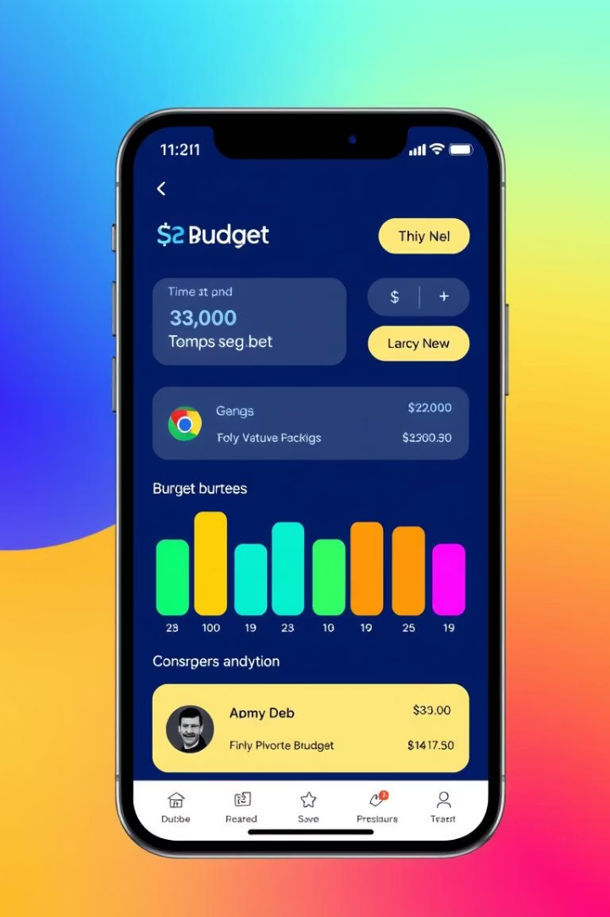
Smart Budgeting: Personalized Insights
Custom Budgets
Set personalized monthly expense limits.
Real-time Tracking
Progress bars display budget usage instantly.
Intelligent Alerts
Receive notifications before overspending occurs.
Personal Tips
Get spending advice based on your habits.

Slide 6
Reporting & Analytics: Understand Your Finances
Monthly and yearly expense reports
Export your financial data as CSV files
Analyze spending trends over time
Allows deeper analysis using external tools
Category-wise expense breakdown

Slide 7
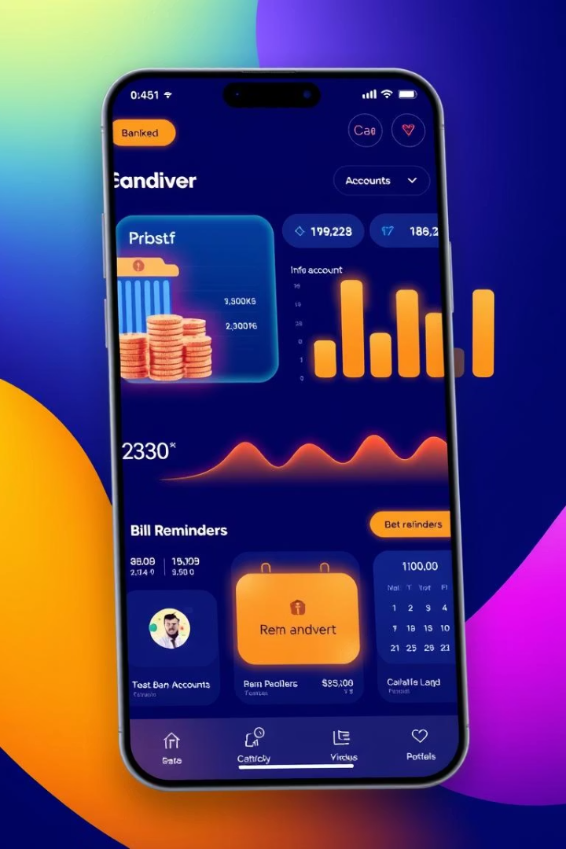
Future Enhancements: Expanding Functionality
Auto Transaction Import
Sync expenses directly from bank accounts.
Investment Tracking
Monitor stocks, cryptocurrencies, and more.
Bill Payment Reminders
Never miss due dates with timely alerts.
Financial Planning Tools
Integrate comprehensive budgeting and investing features.

Slide 8

Conclusion: Empowering Financial Wellness
Cross-Platform Access
Available on both iOS and Android devices.
Goal
Help students and savers achieve financial success.

